Slide 1
Data Abstraction
03

Slide 2

We Must Understand our Data

Slide 3
Data → Vis
06

Slide 4
How to Craft a Visualization?
Data
Visualization

Slide 5
How to Craft a Visualization?
Data
Questions
Visualization

Slide 6
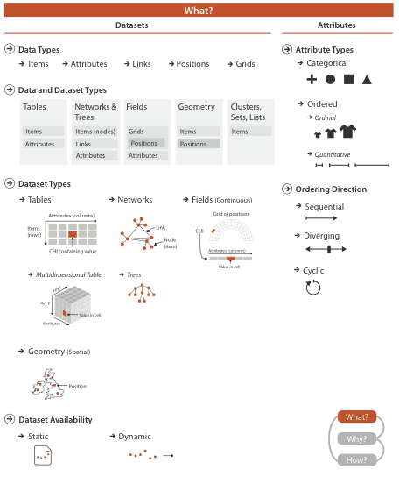
Analysis dimensions

Slide 7
Data Types
01

Slide 8
Five Basic Data Entities (Types)

Slide 9

Items
Notes:
Individual entity, discrete

Slide 10
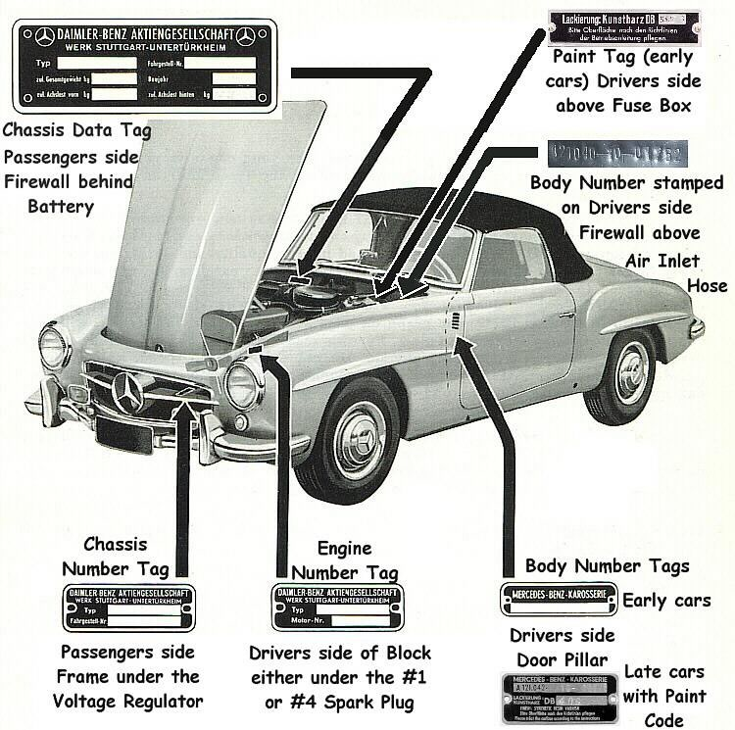
Attributes
Notes:
The object’s properties
Specific, can be measured, observed, logged

Slide 11

Links
Notes:
Relationship between items

Slide 12

Positions
Notes:
Position in 2D or 3D
Geo goes here, for instance (but not only that)

Slide 13
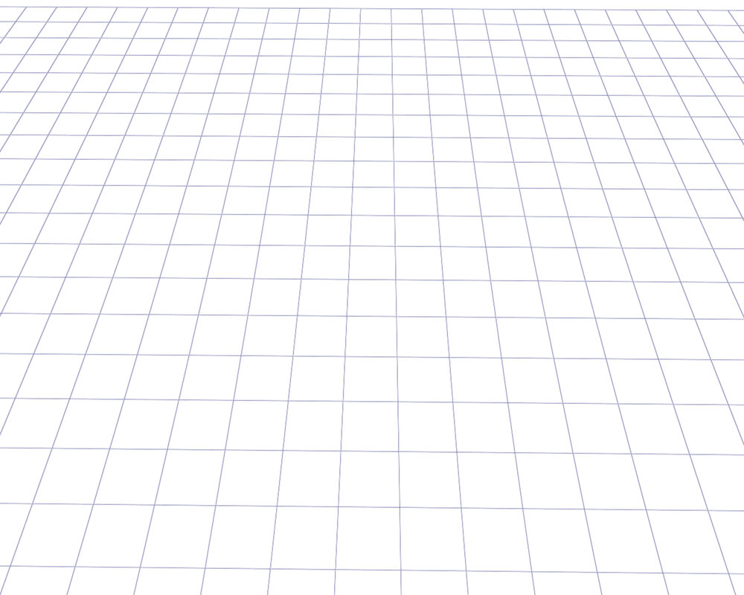
Grids
Notes:
Geometric and topologic relationship between its cells
Used for sampling at regular intervals

Slide 14
Datasets
02

Slide 15
Dataset Availability
Static
On file
unchanging
Dynamic
Dynamic stream
Items added or removed during session

Slide 16
Dataset Types

Slide 17
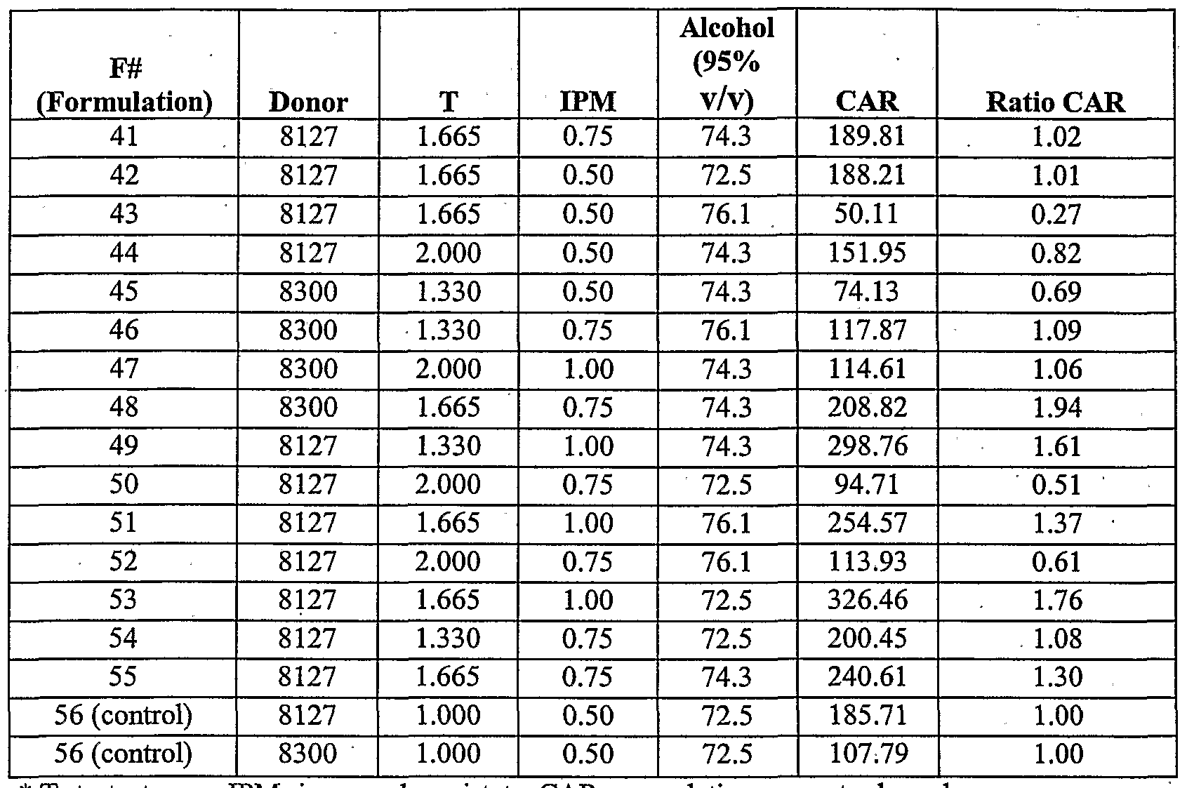
Tables
Attribute
Item

Slide 18
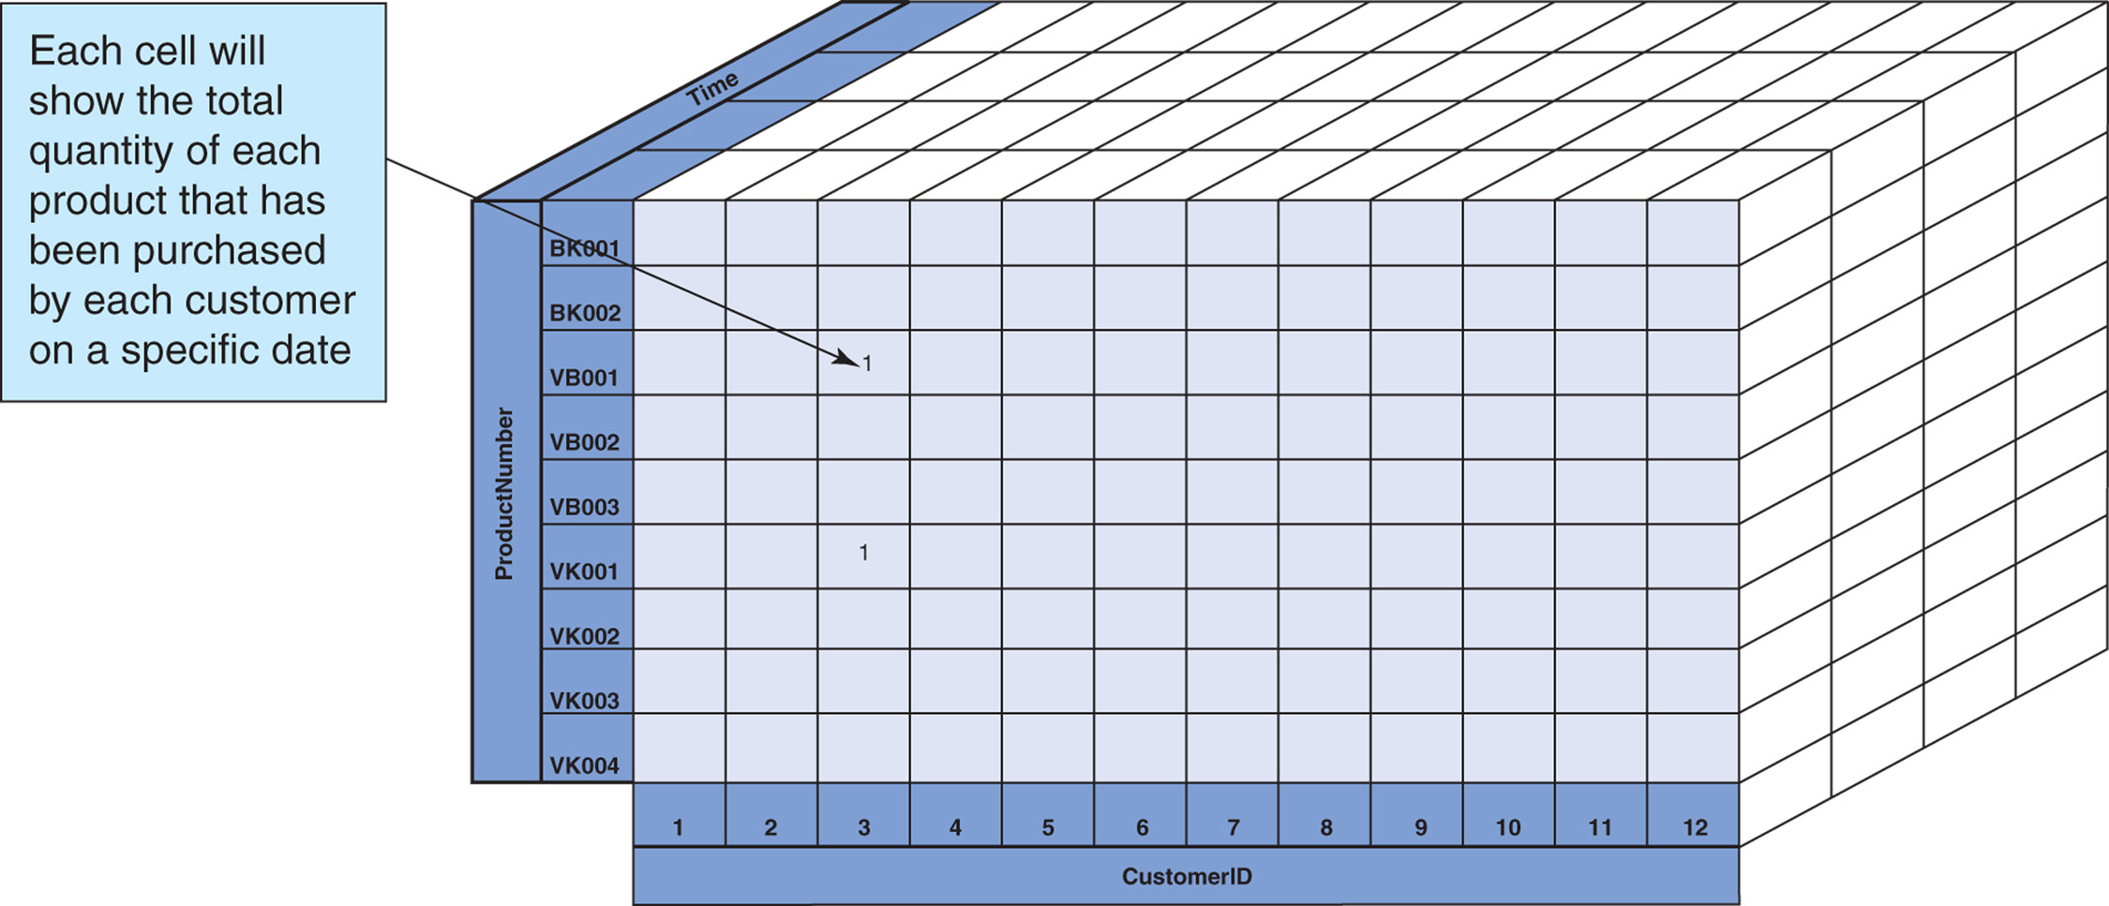
Multidimensional Tables
Notes:
More complex structure
More than one key
Think: datawarehouses, multidimensional cubes

Slide 19
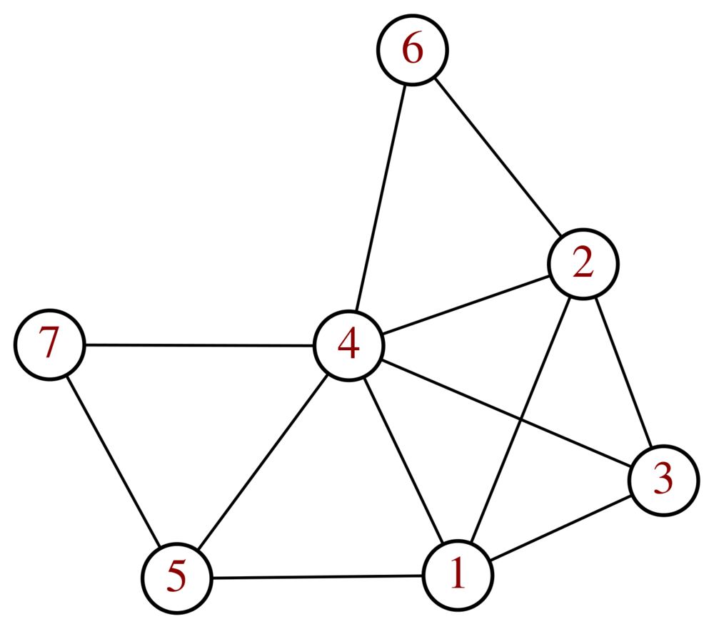
Networks (Graphs)
Item
link
Notes:
Node-link

Slide 20
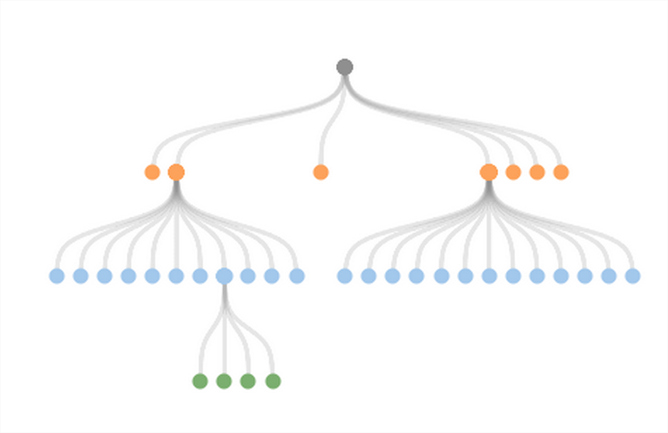
Trees (hierarchies!)
Notes:
A special case of a graph, actually.
No cycles
Each node only has one parent

Slide 21
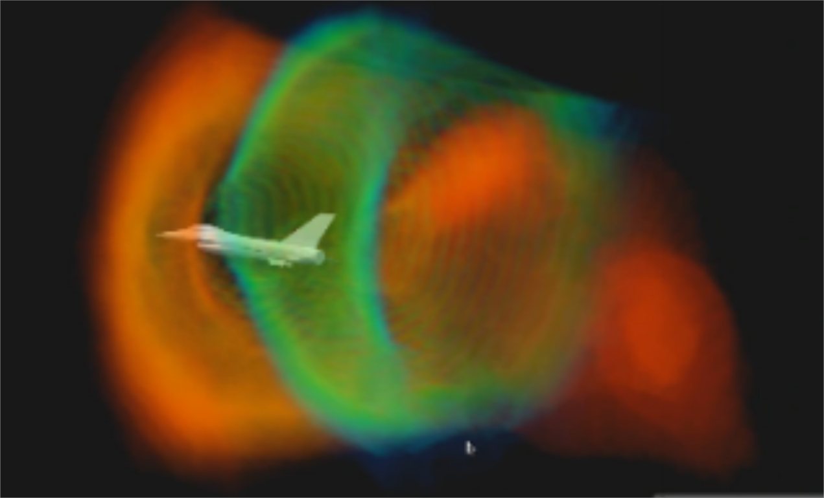
Fields
Continuous, in the real world, sampled
Notes:
Essentially, all that is continuous and can be sampled.
Litmus test: does interpolation make sense?

Slide 22

Spatial Fields – Position matters!
Notes:
Samples have positions. Location and topology important
Not all fields are spatial: A continuous matematical function; temperature over time; etc.

Slide 23
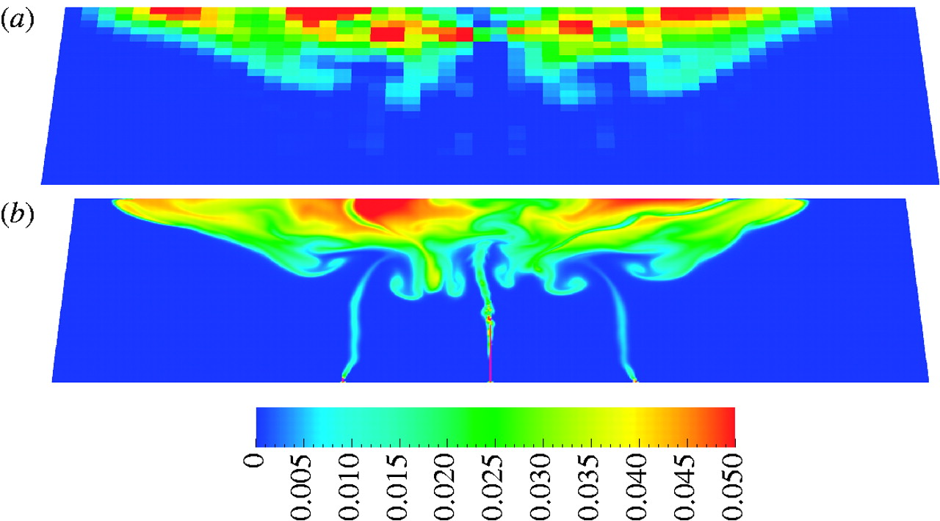
Fields – Sampling
At which intervals? Coarseness

Slide 24
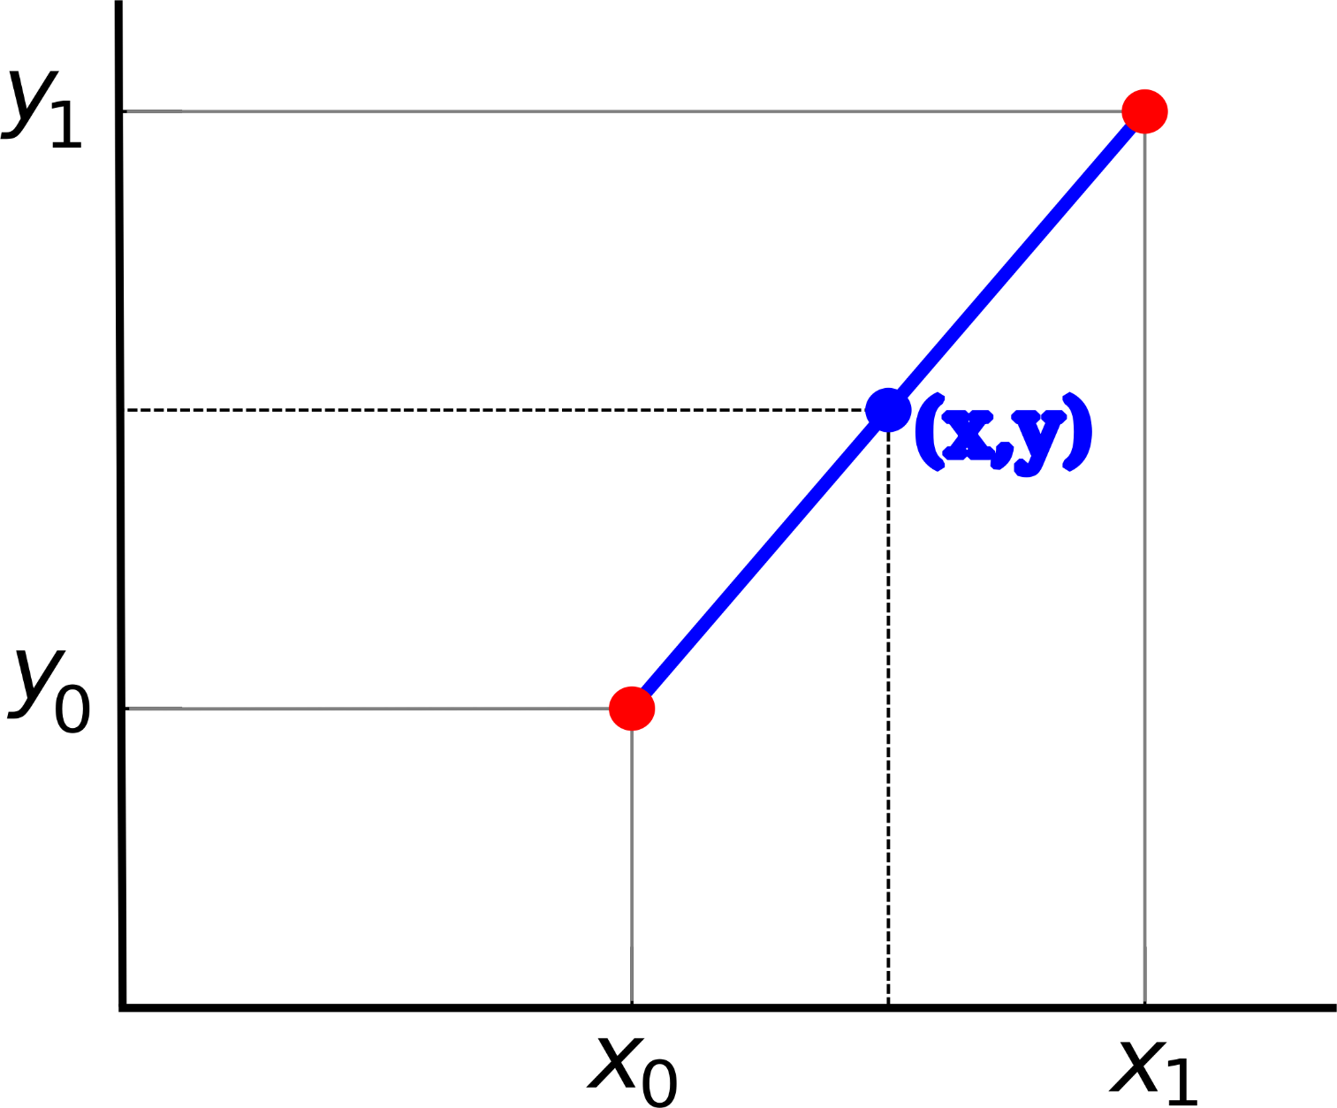
Fields – Interpolation

Slide 25
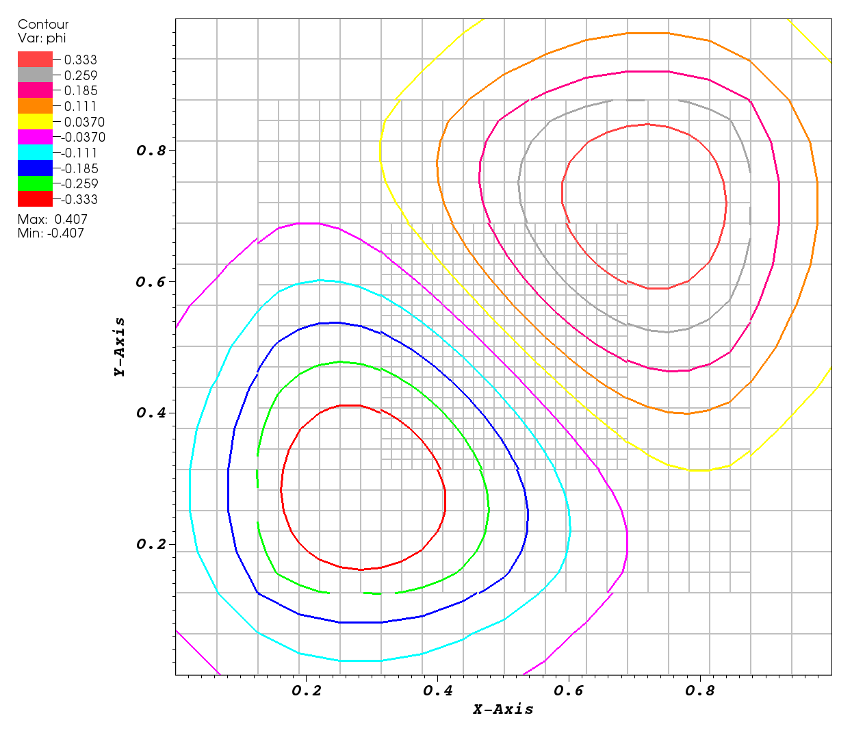
Grids: rectilinear
Notes:
Sample along the grids!
Rectilinear can have rectangles of diferente sizes in the same grid (“regular” if all the same size)

Slide 26
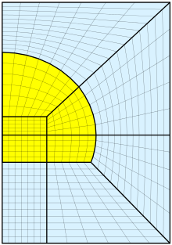
Grids: Structured
Notes:
Can be non-rectilinear, position of each cell must be specified, but topology still implicit

Slide 27
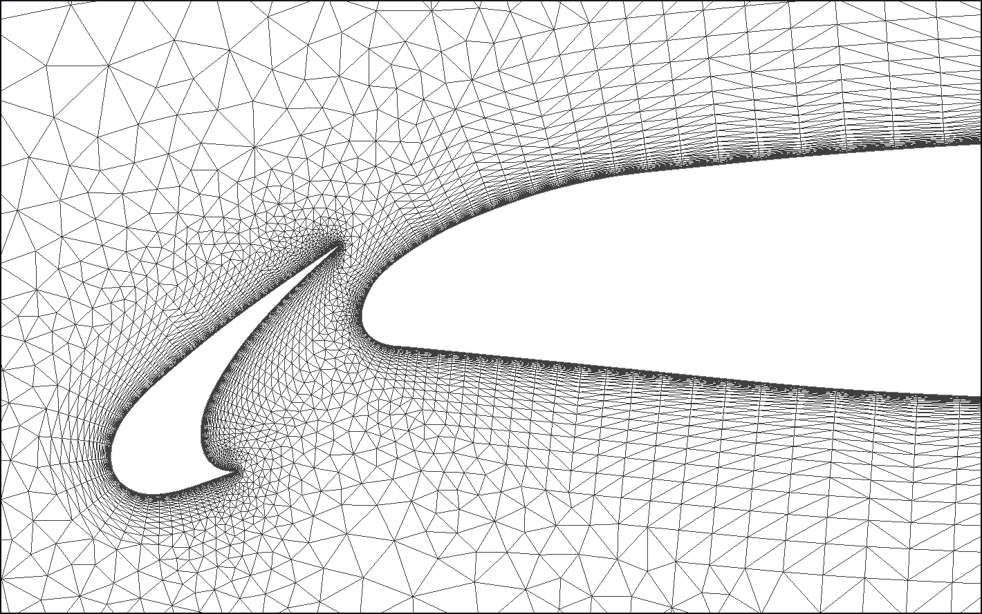
Grids: Unstructured
Notes:
Tesselation is na exemple of this
Cells of whatever shape
Must store information about geometry and topologym

Slide 28
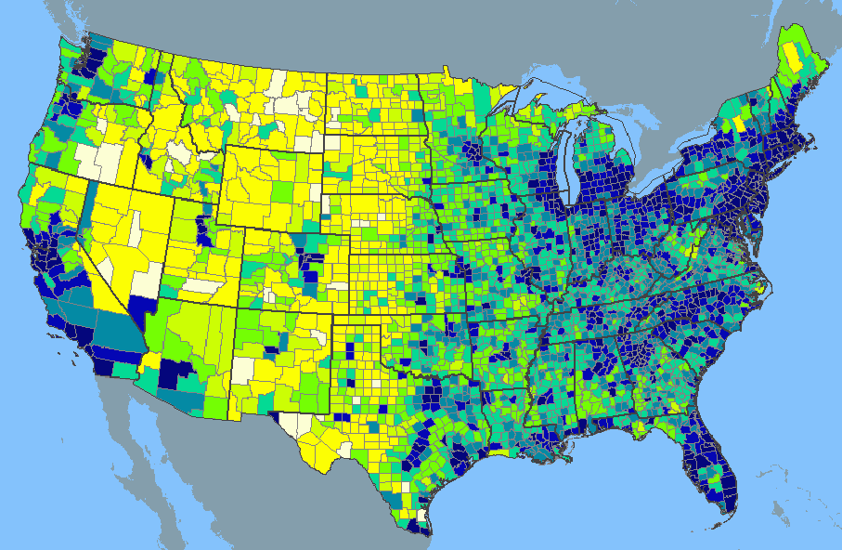
Geometry
Notes:
Position and shape matter (points, lines, polys)
Items (ex: tracks) may not even have attributes. They matter for their position and shape alone

Slide 29
Attribute Types
03

Slide 30
Attribute Types

Slide 31
Attribute Types
Nominal (categorical)
ordered
quantitative
ordinal
ratio
continuous

Slide 32
Attribute Types
Nominal (categorical)
ordered
quantitative
ordinal
ratio
continuous

Slide 33
Attribute Types
Nominal (categorical)
ordered
quantitative
ordinal
ratio
continuous

Slide 34



Nominal (Categorical)
No inherent ordering

Slide 35
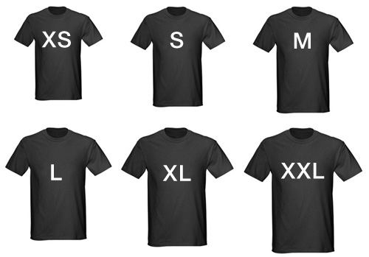
Ordinal
ordered but not measurable
Small/medium/large, hot/warm/cold, like/neutral/dislike

Slide 36

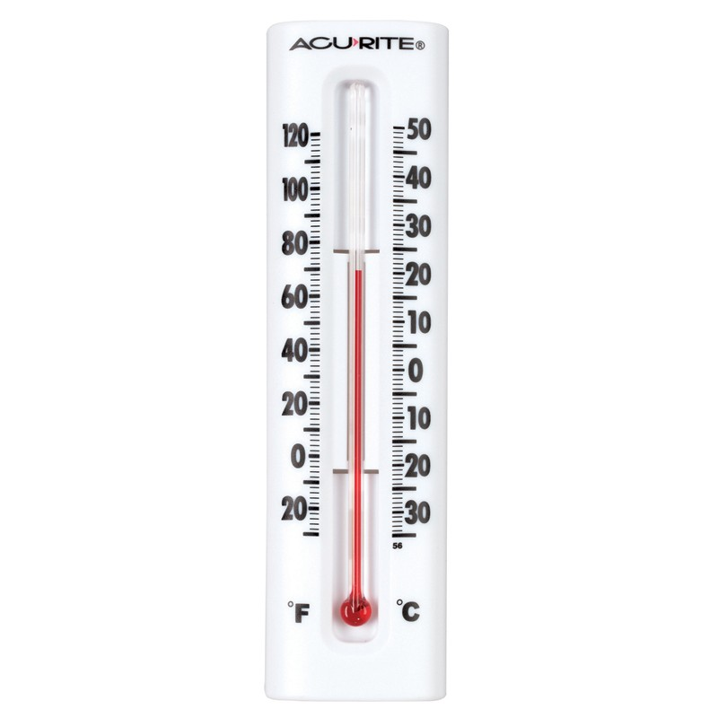
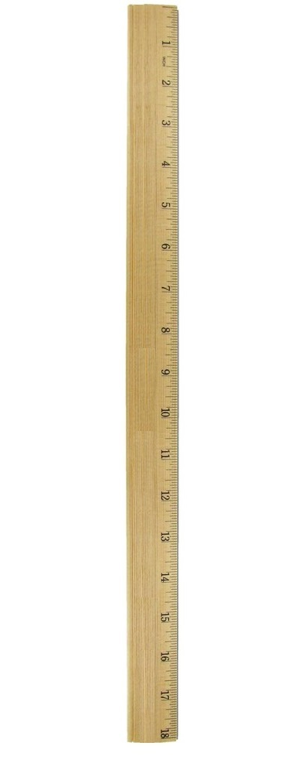

Quantitative
Ordered, measurable
Notes:
Temperature
Length
age

Slide 37
Ratio
Special case: there is a zero! Proportions make sense.
Notes:
Makes sense to tell something is “twice” or “half” the other, for instance
Date: not ratio. “2000 A.D.” is not twice the time as “1000 A.D.”
Temperature (Celcius, at least): not ratio. 40º is not twice as hot as 20º
Height: ratio. 100m is twice as tall as 50m
Age: ratio. 50 years is twice as old as 25.

Slide 38
2m
1m

Slide 39
2m
2m
1m

Slide 40
2m
1m

Slide 41
2m
1m

Slide 42
2m
1m

Slide 43
2m
1m

Slide 44
2m
1m

Slide 45
20º
10º
-5º
-10º

Slide 46
Ratio
*, /
Continuous
+, -
Ordinal
>, <
Nominal
=, <>
Notes:
Useful rules of thumb for

Slide 47
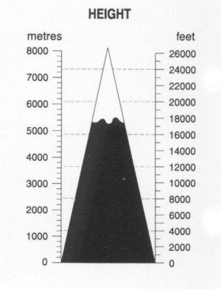
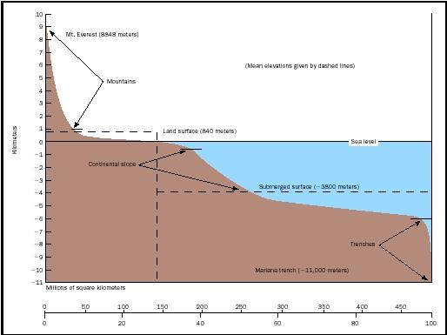
Sequential vs Diverging
Sequential
From a minimum to a maximum
Diverging
From a central point in two directions

Slide 48
Notes:
Useful rules of thumb for

Slide 49

Cyclic

Slide 50
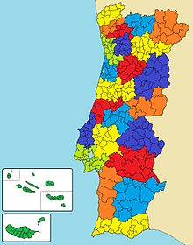
Hierarchical
Year
Week Month
Day
Hour
Minute
seconds
Notes:
Freguesia -> concelho -> distrito -> região -> país
Segundos -> horas -> dias -> meses -> anos
Makes sense to aggregate variables according to the hierarchy
Sometimes, there are different possible ways to aggregate (see time, above)

Slide 51
Semantics
04

Slide 52
First and foremost…
What is its domain-dependant meaning??

Slide 53
Also Semantics
independent/dependent
continuous/discrete
temporal/nontemporal
spatial/nonspatial
…

Slide 54
Key / Value
A.K.A. Independent vs. Dependent Attributes
Keys identify objects we want to see
Usually will have a central role in organizing the vis
Values are usually properties of the objects identified by the keys

Slide 55
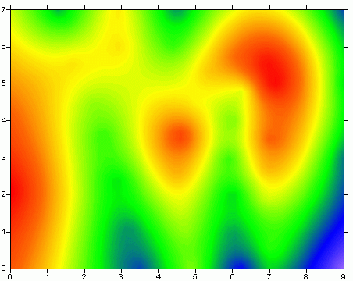
Scalar Fields
Each position, one value

Slide 56
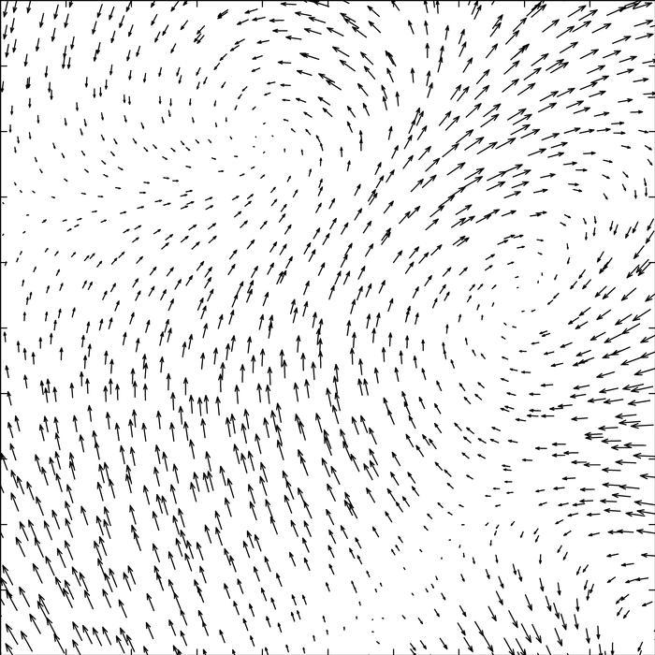
Vector Fields
Each position, one vector

Slide 57
Time-based
Important to show change over time
Aggregations (time scales) relevant
Time as key:
CO2 emissions each hour
Time as value:
Accident records (location, num injured, time)

Slide 58
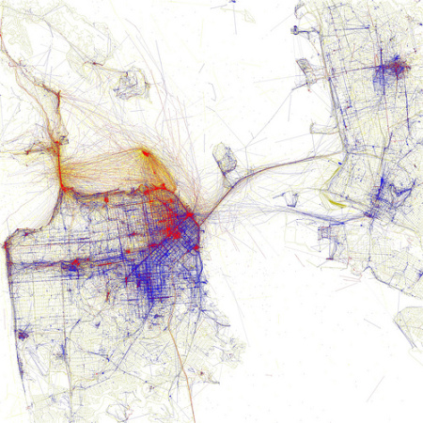
Geo
Position
Aggregations

